Slide 1



Love at First Byte
J-Jay Pechta jpechta.dkg.comcast.net and Tamara Webster websterlawton@gmail.com

Slide 2
Getting to Know You…
How many are members of a state committee or officers in your state?
How many have used gotomeeting before?
Who is using a MacIntosh system?

Slide 3
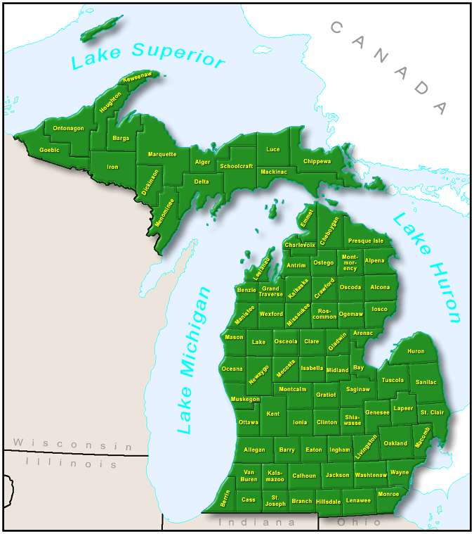
Go To Meeting
Let’s Go to a Meeting in Michigan…
Steps
  Make a meeting with Virginia P. at International
  Get your E-Mail
  Follow the directions.
  Using a Mac, no problem (except having to look at the PC Screen ☺)
Works well on most connections.
The truly timid or unequipped can dial in with their telephones…
Limited to 15 people

Slide 4

Some Follow Up on GTM
Advantages and Disadvantages
  Saves gasoline
  Overcomes REALLY bad Michigan weather
  Not meant to be used at the chapter level (sorry, UP)
Alternative
  Chat (such as G-Mail, Facebook, Yahoo)
  Skype
It is time for questions…

Slide 5
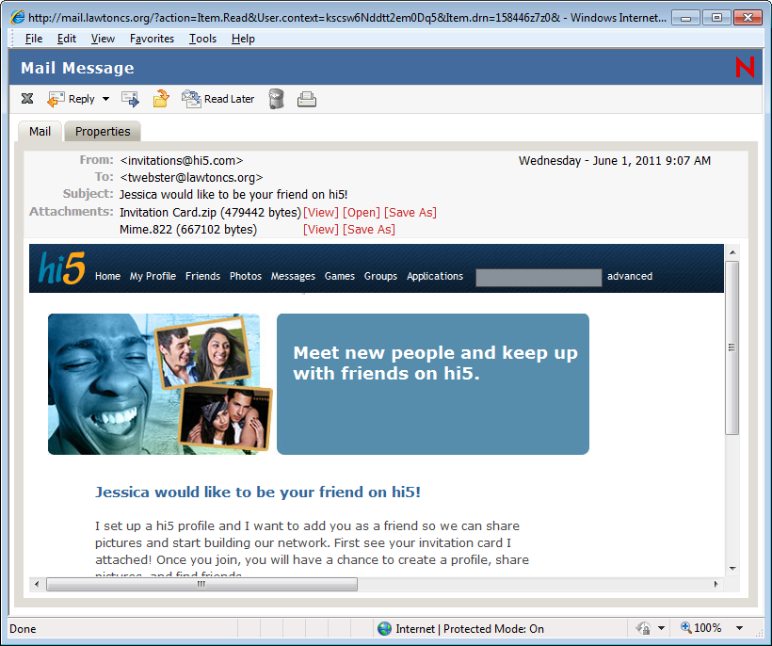
Email and Digital Etiquette…
How do you know that an email is “contaminated”

Slide 7
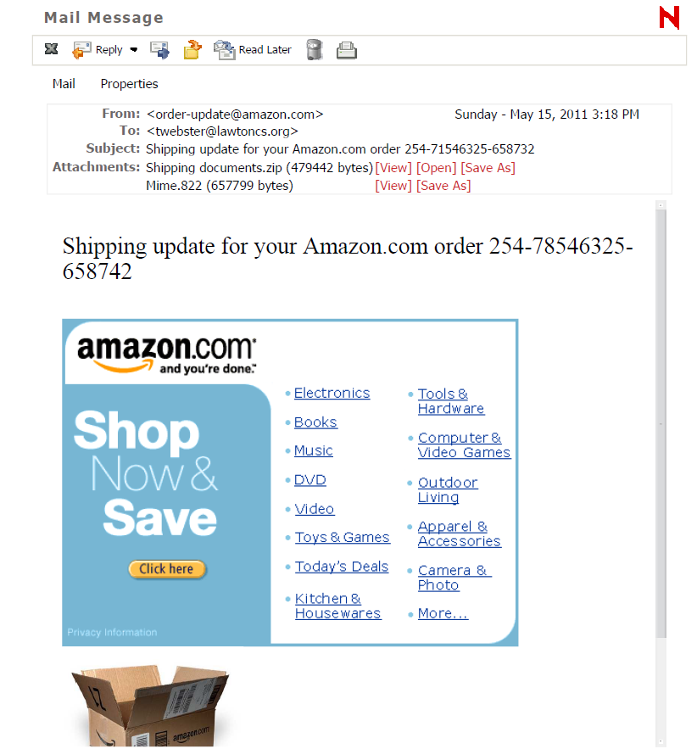

Slide 8
Email and Digital Etiquette…
Acronyms to Make you Blush and other “Web Speak” you should Know :P ☺ ☹ <3 (emoticons)
  Don’t use them unless you are familiar with them.
  Be wary of them from people who maybe shouldn’t be able to use
Netsmartz.org (tips and movies to watch on internet safety for kids including symbols and definitions)
Noslang.com (Top twenty for parents)
  POS
  P911
  MIRL
It is time for questions…

Slide 9
Document Sharing Choices
Email (1 at a time)- management of space
Dropbox and related programs (good for larger files)
  Email links to file you place in the “public folder”
  Log into Dropbox to access files when “the worst happens”
Google documents (both sharers must have an account; however both may edit a single document.

Slide 10
Search Engines
Available search engines
  Metasearch engines
  Directories
  Journal directories and academic searches

Slide 11
Selected Internet Search Engines
Search Engine | Database | Advanced/ Boolean | Other search options | Miscellaneous
Google google.com Advanced Search Ranks based on popularity (# of pages linked to) | Full text of web pages and other documents on the web. | AND (default) OR (capitalized) - to remove words or phrases. + to include common words | * wildcard to replace word(s) (to * or * ) No truncation. Quotes for phrase. Stems some words (+ to turn off). Fields: intitle:, site:, inurl:, filetype: more. Similar pages - finds related sites. | Language translations. ~ searches synonyms (~food) define: finds definitions Tools: math/equivalents calculator, maps, stocks.- more
Bing bing.com Advanced Search | Full text of web pages and other documents on the web. Type up to 150 characters, including spaces, in the search box. | AND (default) OR (capitalized) NOT (capitalized) to exclude words | No truncation. Quotes for phrase. For dates, type the name of the month instead of the calendar number. | Left panel, suggests related searches and shows search history. Translates similar to Google. Use Instant Answers for easy field searching.

Slide 12
Selected Internet Search Engines
Search Engine | Database | Advanced/ Boolean | Other search options | Miscellaneous
Ask.com www.ask .com | Ask natural language questions as well as keyword searches. Plus: Images, News, Video. | Natural language questions, not Boolean searches. | Right sidebar offers links to related search results and search history. | Provides links to image, news and video searches. Offers AskEraser, a search privacy feature.

Slide 13
Selected Internet Meta-Search Engines
Meta-Search Engine | Database | Advanced/ Boolean | Other search options | Miscellaneous
Ixquick ixquick.com | Searches Ask, All the Web, Yahoo, MSN Live, Exalead, Gigablast, EntireWeb, Open Directory, Wikipedia, and others. Customizable. | AND (default), OR, - to exclude. "Translates" complex searches to fit what each search engine "understands." | Picture search. Internatl Phone Directory. | Star rankings tell how many search engines include a match among their top 10 results. Refine search results by clicking check mark to find more like, and X to exclude pages like a result.
ZapMeta zapmeta.com | Searches Yahoo, Bing, Cuil, Gigablast, Altavista, Entireweb, among others. | AND (default), OR, - to exclude. Clusters on right of search result allow zooming in on subsets of results. | Search in English, German or Dutch. | Offers related results by domain as well as topic.

Slide 14
Selected Internet Subject Directories
Subject Directory | Database | Boolean | Other search options | Miscellaneous
Yahoo Directory dir.yahoo.com | Sites are submitted to Yahoo!'s team of editors, who visit and evaluate every site added to the Directory. | AND (default) OR (capitalize) - to remove. | Quotes for phrase. * to truncate. Fields: t:title; u:URL | Search specific types of info: News, Sports, Maps, Weather, Shopping
About.com about.com | Content on About.com is written by a network of more than 750 Guides. About.com adds more than 3,000 new content items each week and approximately ten new topics each month. | AND (default), OR, NOT, Nesting ( ) | Quotes for exact phrase. | Browse "channels" (broad subjects like Jobs & Careers) or "topics" (broad keywords).

Slide 15
Selected Internet Subject Directories
Subject Directory | Database | Boolean | Other search options | Miscellaneous
Infomine infomine.ucr.edu Advanced Search and Browse | Scholarly Internet resources, selected and annotated by (mostly) UC librarians. (over 100K). | AND (default), OR, NEAR, Nesting ( ) | Quotes for phrase; pipes (|term|) for exact word or words; Stemming (can turn on or off in Advanced); * to truncate. Fields: subject; title; author; keyword; description. | Can search all databases or individually. Can browse by subjects in each database.

Slide 16
More about Search Engines
Boolean Searches
  Using the right terms for the right search engines
    + (AND) – (ANDNOT) OR *Wildcard “ “ Domain:org
    Quotation marks and advanced searches
Note!
  Safe search is an advanced option
  There is no “safe search” of photographs in on online search engines but there are safer search engines
    Yahooligans
    Mel.org
    Pics4learning.com

Slide 17
Social Networking
How to be Safe (what to post)
Use DKG Network to social network with DKG friends and colleagues
Who to “Friend” on website
  Friend your children and grandchildren
  Don’t friend anyone else’s minor children (especially those under 14)
  Don’t friend anyone you would not allow in your home when it is “a little bit messy”
What settings are important

Slide 18
Blogging and Creating a Presence on the Web…
A PSA from our Friends at International…
  (There are guidelines to follow if you are doing a website)
Weebly (To make a website)
BlogSpot (Good for Photographs)
Edublogs.org (Safe blogs for educators to share with students)

