Slide 1
World Fellowship
Making a Difference
By Touching a Life
Researched and compiled by Leslie Hamman, Gamma Lambda Indiana
State International Projects Chairman 2013-2015

Slide 2
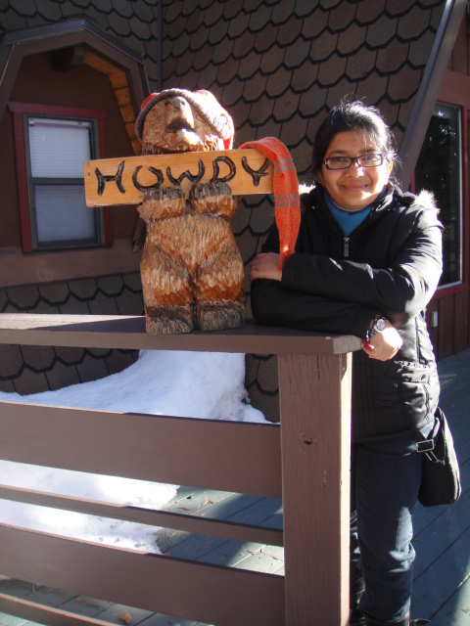
Munasir Kamal
From Bangladesh
to the
University of Nevada-Reno
Masters in Literature

Slide 3
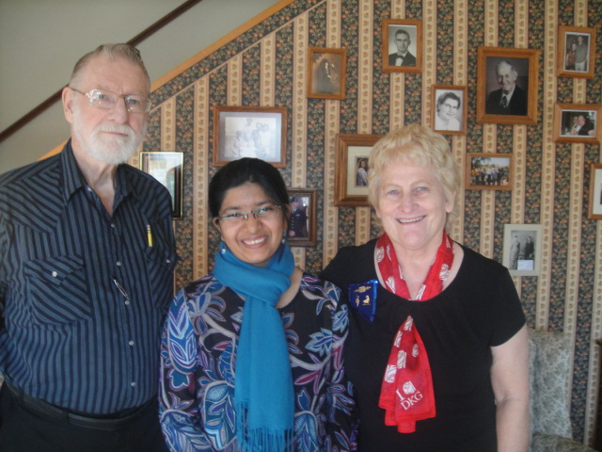
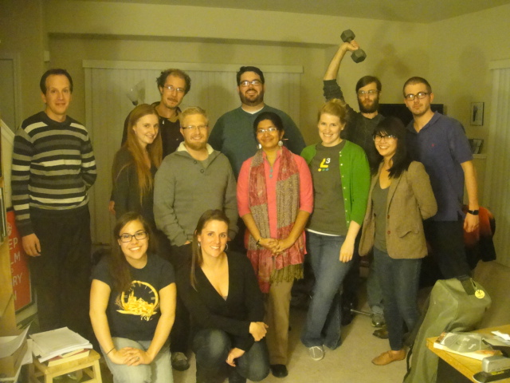
Munasir and her DKG family
Kathy Rothchild and her husband
A Sense of Community

Slide 4
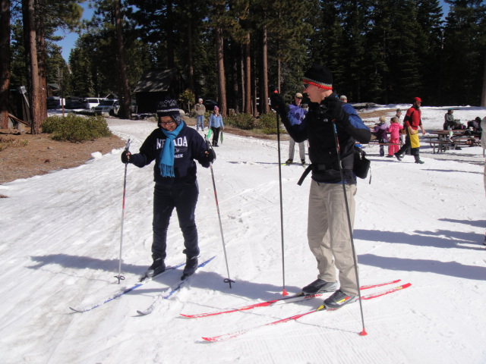
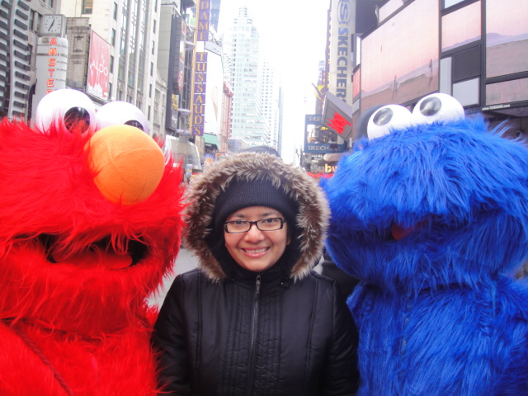
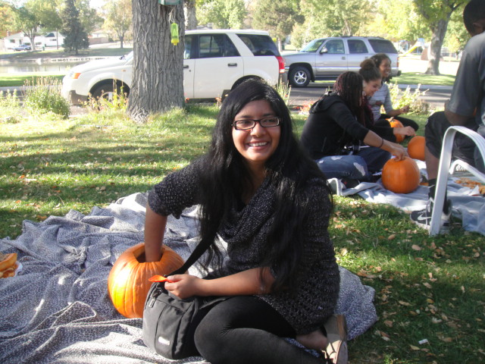
Enjoying New Experiences

Slide 5
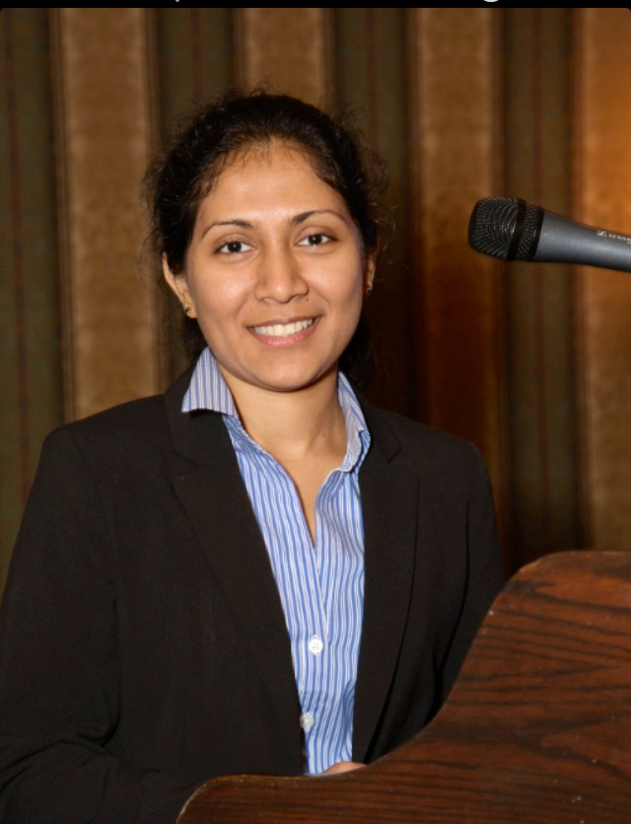
Kohila Mahadevan
A Chance to Speak
From Sri Lanka
to the
University of Toronto
Biochemistry PhD Program

Slide 6
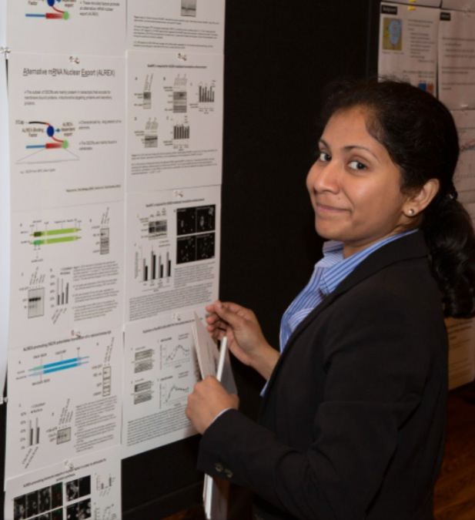
The Joy of Success
Published Author in
Plos Biology, RNA, and Biomedical Research
The promising research continues!
The RanBP2/Nup358, a nuclear pore protein is required to potentiate
translation of subset mRNAs encoding secretory proteins.

Slide 7
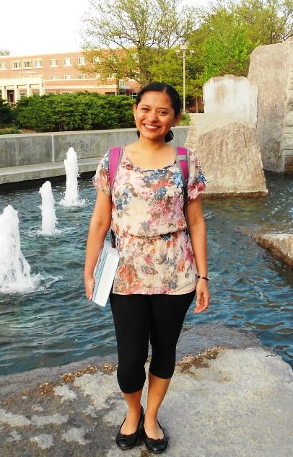
Rubenia Borge
From Nicaragua
to the
University of Nebraska at Omaha
Masters Program
Management Information Systems

Slide 8
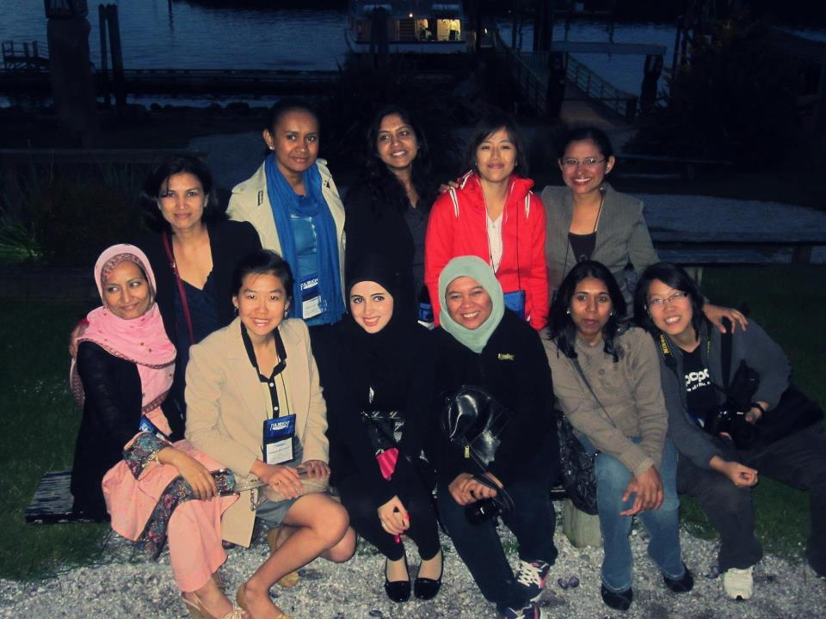
Fulbright Women of the World

Slide 9
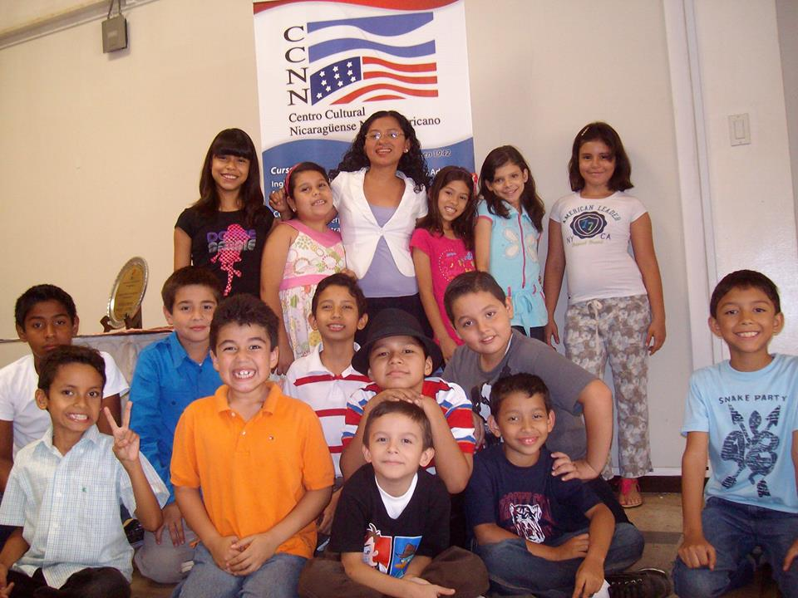
Paying It Forward

Slide 10
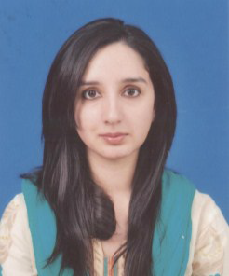
Fatima Hashmi
From Pakistan
to Duke University
Masters Program Environmental Management

Slide 11
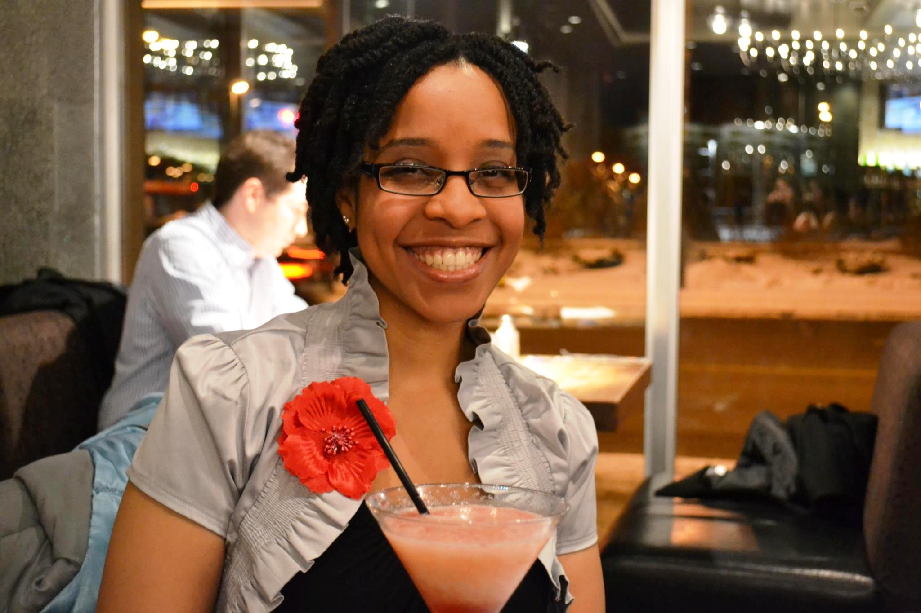
Sonja Angelique Francis
From Trinidad & Tobago to the University of Alberta
Chemistry PhD Program

Slide 12
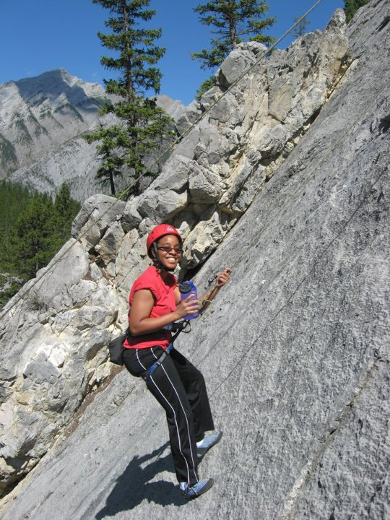
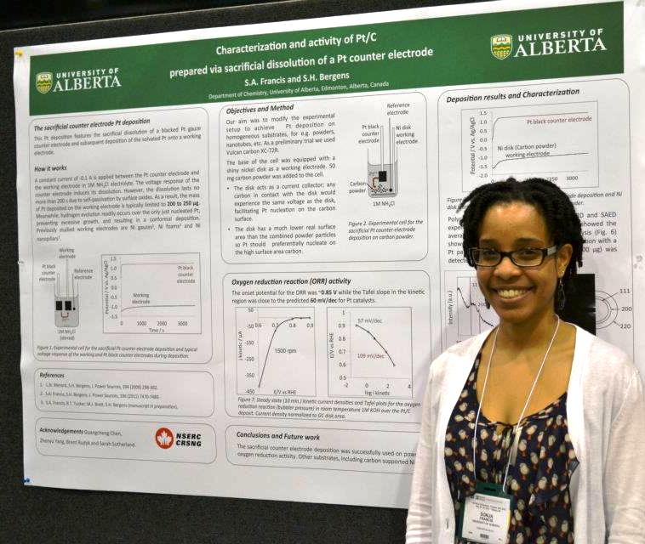
Climbing to New Heights

Slide 13
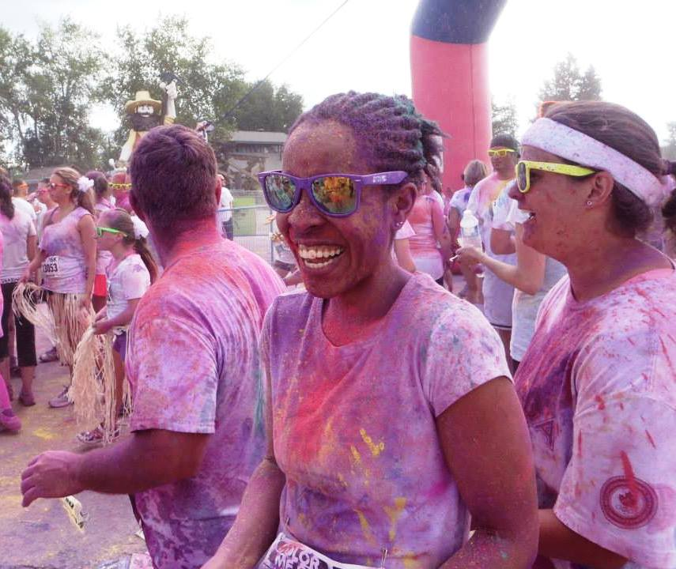
Adding “Color” to the Lives of Women

Slide 14
With your support,
we can continue making a difference!
Contribute to the World Fellowship Fund
by using the online contribution form or Form 43. Both can be accessed at www.dkg.org under Forms, Contribution Forms.

